Slide 1


Fundamentals of Management
Eleventh Edition
Chapter 5
Planning and Goal Setting
Copyright © 2020, 2017, 2015 Pearson Education, Inc. All Rights Reserved

Slide 2
Learning Objectives
5.1 Discuss the nature and purposes of planning.
5.2 Explain what managers do in the strategic management process.
5.3 Compare and contrast approaches to goal setting and planning.
5.4 Discuss contemporary issues in planning.

Slide 3
Learning Objective 5.1
Discuss the nature and purposes of planning.

Slide 4
What Is Planning?
Planning:
The primary management function.

Slide 5
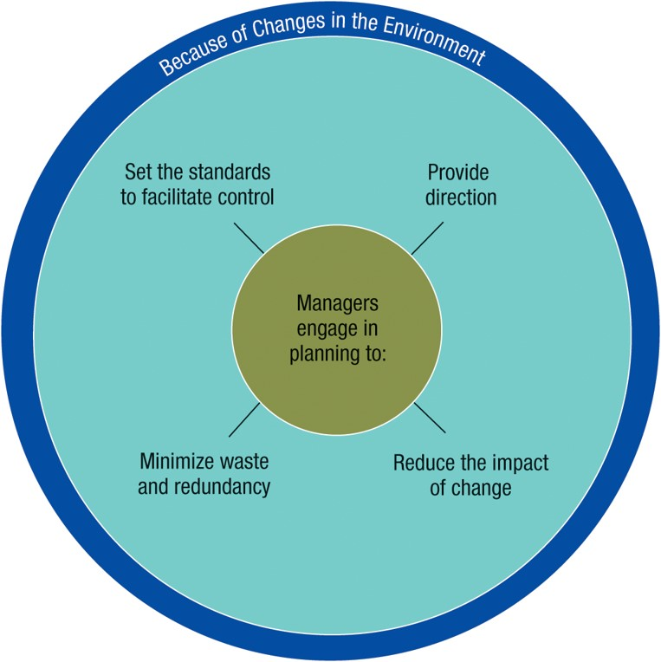
Reasons for Planning
Exhibit 5.1 Reasons for Planning

Slide 6
Criticisms of Formal Planning
May create rigidity
Can’t replace intuition and creativity
Focuses attention on today’s success, not tomorrow’s survival
Reinforces success, which may lead to failure

Slide 7
Formal Planning and Organizational Performance
Does it pay to plan?
Higher profits
Higher return on assets
Improved quality of planning
Appropriate implementation

Slide 8
Learning Objective 5.2
Explain what managers do in the strategic management process.

Slide 9
What Is Strategic Management?
Strategic management:
what managers do to develop an organization’s strategies
Strategies:
plans for how the organization will do what it’s in business to do, how it will compete successfully, and how it will attract its customers in order to achieve its goals

Slide 10
The Importance of Strategic Management
It has a positive impact on organizational performance
It prepares managers to cope with changing situations
It guides managers to examine relevant factors in planning future action

Slide 11
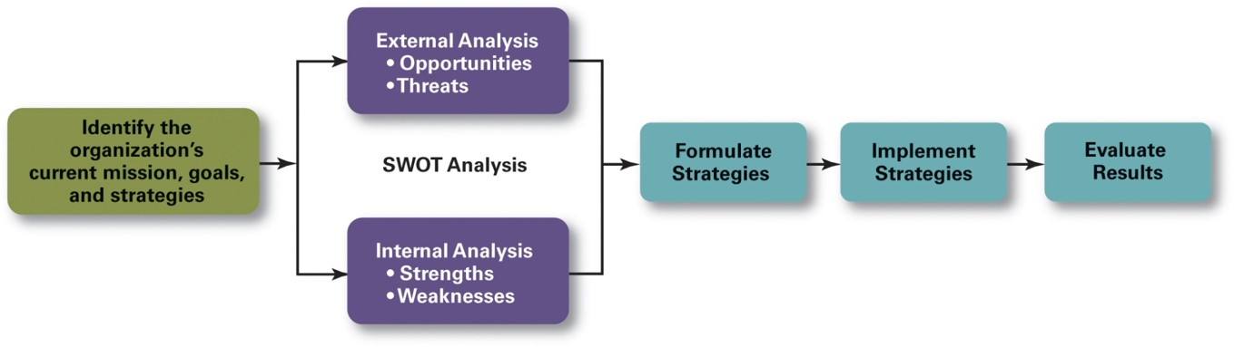
Steps in the Strategic Management Process
Exhibit 5.2 The Strategic Management Process

Slide 12
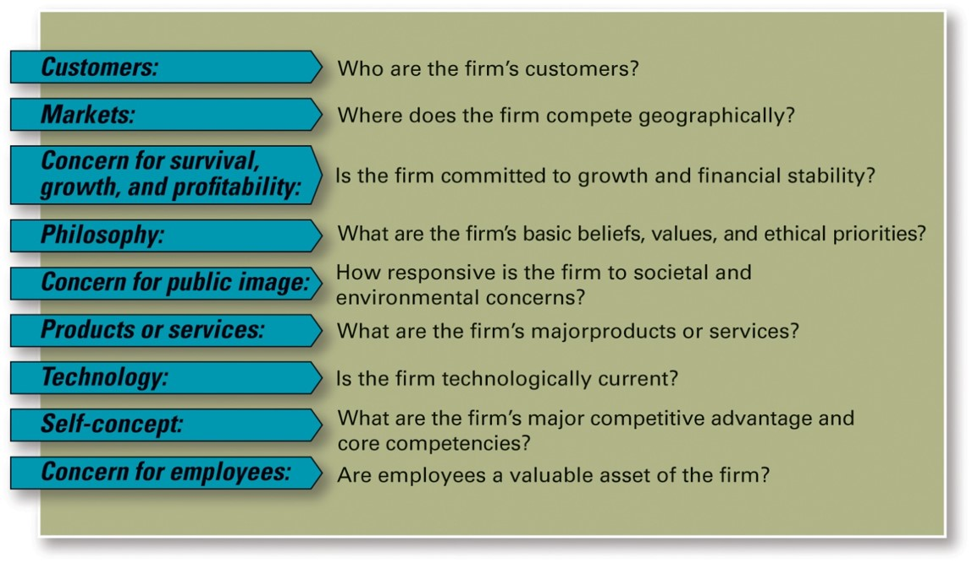
Identify Mission, Goals, and Strategies
Exhibit 5.3 Components of a Mission Statement
Source: Robbins, Stephen P., Coulter, Mary, Management, 13th E d., © 2016, p. 238. Reprinted and electronically reproduced by permission of Pearson Education, Inc., New York, N Y.

Slide 13
External and Internal Analyses
Step 2: External Analysis
Competition
Components of environment
Threats and opportunities
Step 3: Internal Analysis
Resources
Capabilities
Core competencies
Organizational strengths and weaknesses

Slide 14
Formulating, Implementing, and Evaluating Results
Step 4: Formulate Strategies
Corporate
Business
Functional
Step 6: Evaluate Results
How effective have strategies been?
What adjustments are necessary?
Step 5: Implement Strategies

Slide 15
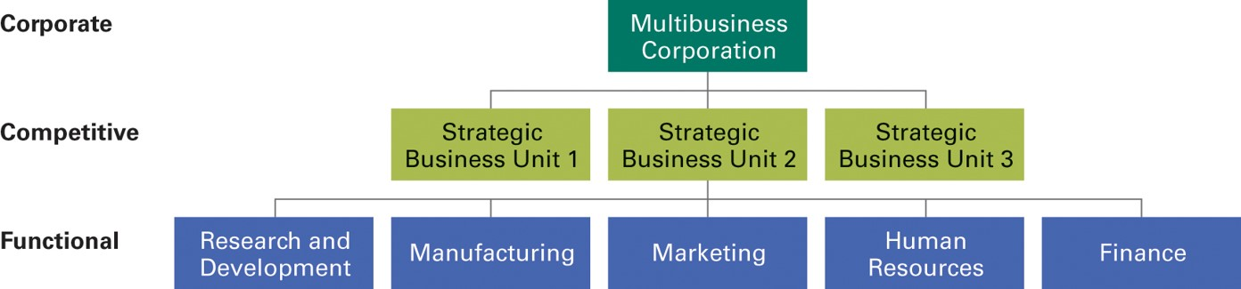
Strategies Managers Use
Exhibit 5.4 Organizational Strategies

Slide 16
Growth Strategy
An organization expands the number of markets served or products offered
  Concentration
  Vertical integration
  Horizontal integration
  Diversification

Slide 17
Stability and Renewal Strategies
Stability strategy
Organization continues to do what it’s doing
Renewal strategy
Organization addresses declining organizational performance
  Retrenchment
  Turnaround

Slide 18
Competitive Strategy
Competitive strategy:
a strategy for how an organization will compete in its business.

Slide 19
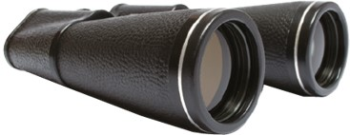
Competitive Advantage
What sets an organization apart; its distinctive edge that comes from its:
  core competencies and resources
Porter’s competitive strategies framework:
1 Cost leadership strategy | 2 Differentiation strategy | 3 Focus strategy | 4 Stuck in the middle
Having the lowest costs in its industry and aimed at broad market. Highly efficient. Overhead kept to a minimum. Does everything it can to cut costs. Product must be perceived as comparable in quality to that offered by rivals or at least acceptable to buyers. | Offering unique products that are widely valued by customers and aimed at broad market. Product differences: exceptionally high quality, extraordinary service, innovative design, technological capability, or an unusually positive brand image. | A cost advantage (cost focus) or a differentiation advantage (differentiation focus) in a narrow segment or niche (which can be based on product variety, customer type, distribution channel, or geographical location). A photo shows a pair of binoculars. | What happens if an organization can’t develop a cost or differentiation advantage—bad place to be.

Slide 20
Functional Strategy
Those strategies used by an organization’s various functional departments to support the competitive strategy
Research and Development
Manufacturing
Marketing
Human Resources
Finance

Slide 21

Strategic Weapons
Customer service
Employee skills & loyalty
Innovation
Quality
Social media
Big data/digital tools

Slide 22
Learning Objective 5.3
Compare and contrast approaches to goal setting and planning.

Slide 23
Setting Goals and Developing Plans
Types of goals
Financial versus strategic
Stated versus real
Planning = goals + plans

Slide 24
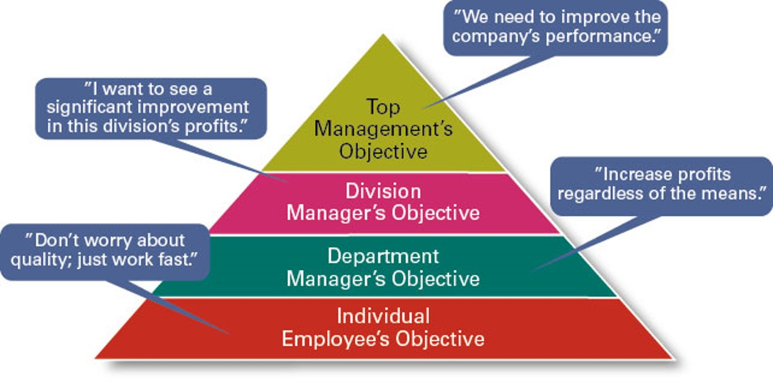
Traditional Goal Setting
Exhibit 5.5 Traditional Goal Setting

Slide 25
Management by Objectives
Goal specificity
Participative decision making
Explicit time period
Performance feedback

Slide 26
Well-Written Goals
Written in terms of outcomes rather than actions
Measurable and quantifiable
Clear as to a time frame
Challenging yet attainable
Written down
Communicated to all necessary organizational members

Slide 27
Steps in Goal Setting
Review the organization’s mission and employees’ key job tasks.
Evaluate available resources.
Determine the goals individually or with input from others.
Make sure goals are well written and communicate to all who need to know.
Build in feedback mechanisms to assess goal progress.
Link rewards to goal attainment.

Slide 28

Types of Plans
Exhibit 5.7 Types of Plans
BREADTH OF USE | TIME FRAME | SPECIFICITY | FREQUENCY OF USE
Strategic | Long term | Directional | Single use
Tactical | Short term | Specific | Standing
Flexibility ↔ Clarity

Slide 29
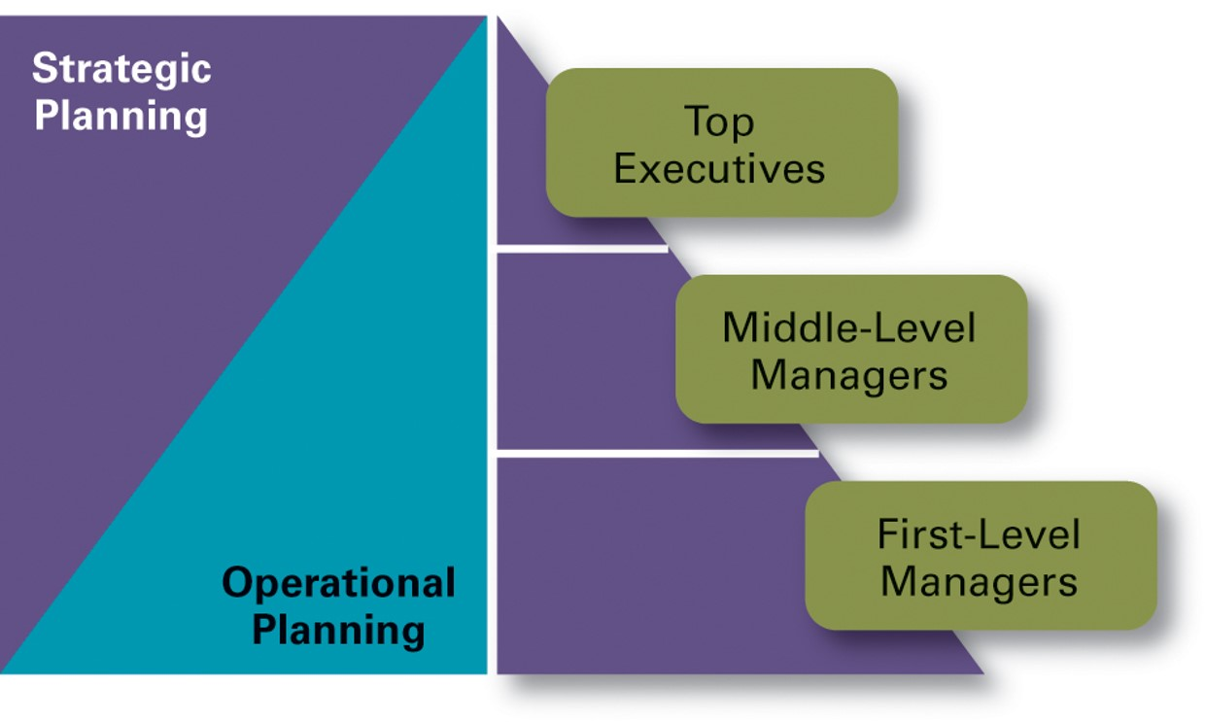
Developing Plans
Exhibit 5.8 Planning and Organizational Level

Slide 30

Approaches to Planning
Top-down traditional approach
Development by organizational members

Slide 31
Learning Objective 5.4
Discuss contemporary issues in planning.

Slide 32
Contemporary Issues
Planning in dynamic environments
Crisis situations
Environmental scanning
Dynamic Environments and
Crisis Situations = Planning Challenges

Slide 33

Copyright
This work is protected by United States copyright laws and is provided solely for the use of instructors in teaching their courses and assessing student learning. Dissemination or sale of any part of this work (including on the World Wide Web) will destroy the integrity of the work and is not permitted. The work and materials from it should never be made available to students except by instructors using the accompanying text in their classes. All recipients of this work are expected to abide by these restrictions and to honor the intended pedagogical purposes and the needs of other instructors who rely on these materials.

